Slide 1
What is Maven?
What is an Artifact?
What is Vulnerability?
Understanding Maven Global Server
Understanding Maven Local Repository
Steps to install Maven on the local machine

Slide 2
What Is Maven
Maven is a build and project management tool that is generally used in frameworks built in Java. It is developed by Apache Software Foundation. Maven, a word from the Yiddish language, means ‘gatherer of knowledge’. It was introduced to make the process of triggering build in the Jakarta Turbine Project.
Maven is controlled by the Project Object Model (pom) file. While working with frameworks built-in in Java, we often have to deal with a number of dependencies.
Before Maven came into the picture, all dependencies, that are nothing but JAR files had to be added to our framework manually. Also, we needed to take care of the software upgrade in our project.

Slide 3
What Is Maven
Maven ensures that project JARs and libraries are downloaded automatically. Only the information relating to the versions of the software and the type of dependencies need to be described in the pom .xml file.
Maven can take care of projects in Ruby, C#, and other languages. It takes up the task of building projects, their dependencies, and documentation.
ANT, another tool developed by Apache Software Foundation, is also used for the building and deployment of projects. But Maven is more advanced than ANT. Like ANT, Maven has made the process of building simple. Thus, in short, Maven has made the life of developers easy.

Slide 4
Why Use Maven
Maven performs the below activities:
Repository to get the dependencies.
Having a similar folder structure across the organization.
Integration with Continuous Integration tools like Jenkins.
Plugins for test execution.
It provides information on how the software/ project is being developed.
The build process is made simpler and consistent.
Provides guidelines for the best practices to be followed in the project.
Enhances project performance.
Easy to move to new attributes of Maven.
Integration with version control tools like Git.

Slide 5
Why Use Maven
Maven takes care of processes like releases, distribution, reporting, builds, documentation, and SCMs. Maven connects to the Maven Central repository and loads them locally. Some of the IDEs that support project development with Maven are NetBeans, Eclipse, IntelliJ, and so on.
Maven should be used in our projects in the following scenarios:
If the project requires a large number of dependencies.
If the version of the dependencies needs frequent up-gradation.
If the project needs to have quick documentation, compiling, and packaging of the source code into JAR or ZIP files.

Slide 6
Operational Steps Of Maven
First Maven goes through the POM .xml file.
The dependencies are loaded into the local repository.
Goes through the built-in life cycles of Maven as shown below:
Default: Takes care of the deployment of the project.
Clean: Removes any errors, thereby cleaning the project, and removing the artifact produced from the previous process of the build.
Site: Takes care of the documentation of the project.
Each built-in cycles have several phases. For example, default has twenty-three phases while clean and site have three and four phases respectively.
Each Maven cycle goes through several stages where a particular stage has a specific objective.

Slide 7
Operational Steps Of Maven
Some of the important phases are listed below:
Validate Verifies if all the prerequisite data for the build to complete are available.
Compile: Source code is compiled.
Test- compile: Test source code is compiled.
Test: Unit test cases are executed.
Package: Source code is compiled and packaged into JAR or ZIP files.
Integration- test: The package is deployed and if there are any issues, integration test cases are executed.
Install-Package: It is installed in the local repository.
Deploy: A copy of the package is made available from the remote repository.

Slide 8
Operational Steps Of Maven
These phases have to be executed in order. Also, if the deploy phase i.e. the end phase of the Maven cycle has to be executed then all the prior phases to that cycle have to be completed successfully.
From the command prompt, the phases are run in the following way:

Slide 9
Operational Steps Of Maven
mvn <name of phase>, for example, mvn validate
A group of Maven goals makes up a phase. Just like phases of Maven, each goal has to be run in a specific order.
A goal has the following syntax:
Plugin: goal
Here, we have discussed some of the phases along with the goals tied to them:
compiler: compile ( used in the phase of compilation)
compiler: test ( used in the phase of test compilation )
surefire: test ( used in the phase of testing )
install: install ( used in the phase of installation )
jar: war ( used in the phase of packaging )
war: war ( used in the phase of packaging )

Slide 10
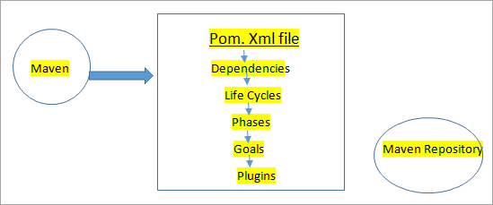
The operational steps of how Maven works are diagrammatically shown below:

Slide 11
Operational Steps Of Maven
mvn <name of phase>, for example, mvn validate
A group of Maven goals makes up a phase. Just like phases of Maven, each goal has to be run in a specific order.
A goal has the following syntax:
Plugin: goal
Here, we have discussed some of the phases along with the goals tied to them:
compiler: compile ( used in the phase of compilation)
compiler: test ( used in the phase of test compilation )
surefire: test ( used in the phase of testing )
install: install ( used in the phase of installation )
jar: war ( used in the phase of packaging )
war: war ( used in the phase of packaging )

Slide 12
Terminologies In Maven
POM: It stands for Project Object Model. It is an XML file that has information about the project, the dependencies present in the project, the directory of the source file, plugin information, and so on. These are the necessary data for Maven to completely build the project. Maven reads the pom file to get all this information.
GroupId: Recognizes our project uniquely from all the projects. GroupId is a part of the pom file. It is often said as an identity for the group of projects.
ArtifactId: A jar file that is deployed to the Maven repository. ArtifactId is a part of the pom file. It is often said to be the identity and name of our project.
Version: Specifies the version of the jar of the project. Version is also a part of the pom file.
As depicted in the image above, we can see that <groupId> , <artifactId> and <version> tags form the part of the dependencies defined for the project.
Maven Central Repository: This is the placeholder where jars, libraries, plugins, and configuration data required by Maven for building the project are present.

Slide 13
Maven Repository
Maven Repository can be of three types:
Local Repository
Remote Repository
Central Repository
Once Maven reads the dependencies from the POM file, it first searches them in the local repository, then to the central, and finally to the remote repository. If the dependencies are not found in any of the three repositories, then the user is notified with an error and the process is stopped.

Slide 14
Maven Repository
Maven Local Repository
The local repository is located in our local system – mostly in .m2 (C:/Users /superdev /.m2) directory which shows its presence once Maven is installed in our system and we have been able to successfully execute a Maven command.
It is also possible to modify this location in settings.xml (MAVEN_HOME /conf /settings.xml) with the help of the localRepository tag.

Slide 15
Maven Repository
Maven Central Repository
Central repository is developed by the Apache Maven group and is hosted on the web. This is considered as the central repository and it has all the common libraries. Like a local repository, we can also modify the location where they are to be downloaded by default by changing the setting.xml.

Slide 16
Maven Repository
Maven Remote Repository
A remote repository is also hosted on the web. In some scenarios, a company can develop its own remote repository and perform deployments on its private projects. These will be owned by that specific company and can be operated only inside it.
The remote repository has similar working patterns to a central repository. Whenever any dependencies or configurations are required from these repositories, they shall first be downloaded into our local and then used.

Slide 17
Maven POM (Project Object Model)
Project Object Model or POM is the basic part of the Maven functionality. This is an XML file that has information on the dependencies, configurations, and other important information about the project. Maven goes through this information and then performs the designated task.

Slide 18
Given below is the list of information that the pom.xml file contains:
Project dependencies
Plugins
Goals for the project
Profiles
Version
Description of the project
Distribution list
Developers
Directory of the source folder
Directory of build
Directory of the test source

Slide 19
What Is Super POM?
There is a parent-child relationship between the POM files in a project. The pom file we developed for our specific project inherits the properties of the super pom.
What Is Minimal POM Configuration?
The minimal pom configuration refers to the groupId, artifactId, and version defined for our project. It is easy and simple to describe minimal pom configuration.
Notes:
<project> <modelVersion> 1.0 </modelVersion> <groupId > com.TestProject </groupId> <artifactId > MavenJavaProject </artifactId> <version > 3.0 </version> </project>

Slide 20
What Is Default POM Configuration?
The default pom configuration solely depends on the archtype. For example in a Maven project that has quickstart archtype, by default, has a pom file shown below.
Notes:
<project> <modelVersion> 1.0 </modelVersion> <groupId > com.TestProject </groupId> <artifactId > MavenJavaProject </artifactId> <version > 3.0 </version> </project>

Slide 21
What Is Default POM Configuration?
<project xmlns="http://maven.apache.org/POM/4.0.0" xmlns:xsi="http://www.w3.org/2001/XMLSchema-instance" xsi:schemaLocation="http://maven.apache.org/POM/4.0.0 https://maven.apache.org/xsd/maven-4.0.0.xsd">
<modelVersion> 3.8.0 </modelVersion>
<groupId> KeywordFramework </groupId>
<artifactId> Excel </artifactId>
<version> 0.0.1-S </version>
<dependencies>
< !-- https://mvnrepository.com/artifact/org.apache.poi/poi-ooxml -->
<dependency>
<groupId> org.apache.poi </groupId>
<artifactId> poi-ooxml </artifactId>
<version> 4.1.1 </version>
</dependency>
< !-- https://mvnrepository.com/artifact/org.apache.poi/poi -->
<dependency>
<groupId> org.apache.poi </groupId>
<artifactId> poi </artifactId>
<version> 4.1.1 </version>
</dependency>
</dependencies>
</project>

Slide 22
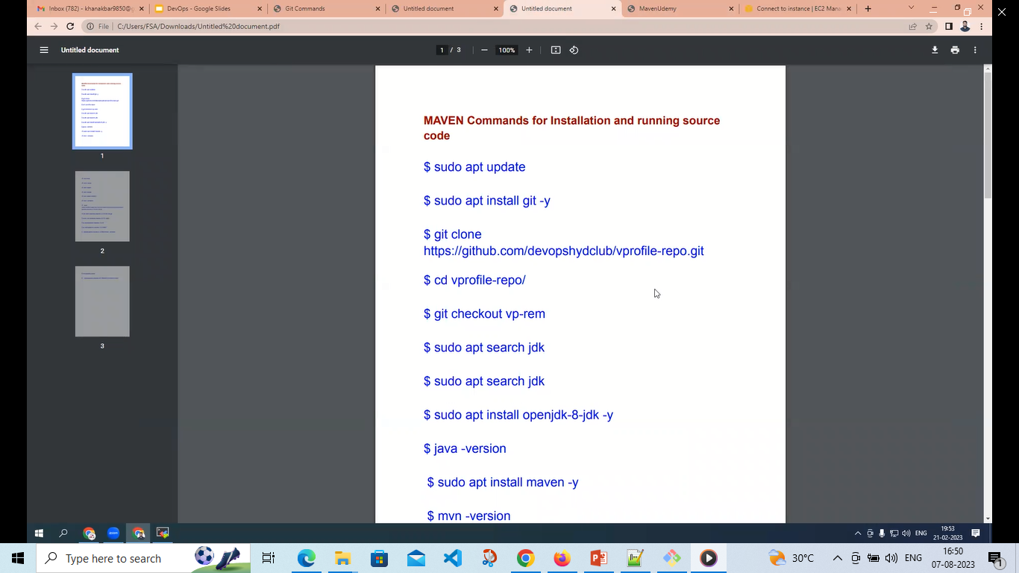

Slide 23
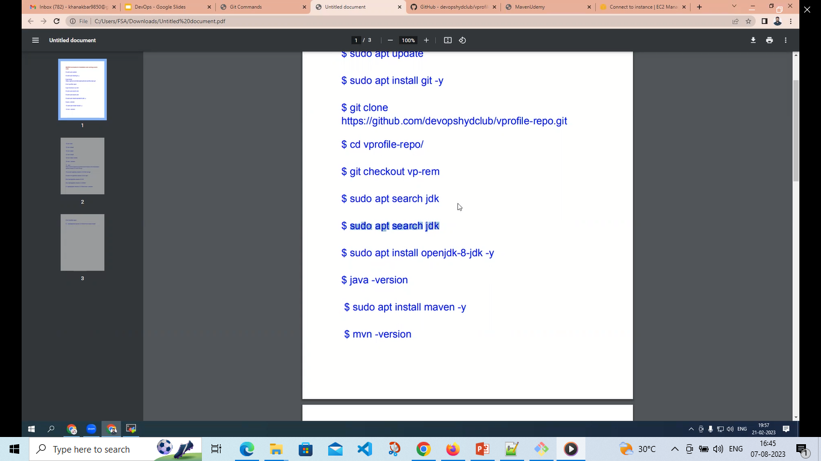

Slide 25
